Slide 1

Event Handling and Buttons
Lesson 4

Slide 2
What the Lesson Will Cover
Know what event handling is
Understand what selection is
Use buttons to add control to a program
Learn how to add responses to button presses
How to combine button presses
Notes:
Introduce the lesson and what it will cover, Learners could discuss or ask question about what the lesson might involve.

Slide 3
Using Buttons
Think about all the buttons that you use everyday, maybe make a list
Buttons are usually switches:
They turn things ON and OFF
They enable us to control
The micro:bit has two buttons A and B which can be used to take control!
We can assign actions or responses to each button
Let’s look at an example
Notes:
Get students to make a list or discuss the wide range of buttons that they use everyday, think of a works without buttons, how would we control the world around us?

Slide 4

How a Button Works
Think of a switch – it can be either ON or OFF
A circuit is a path that electrical current can flow along to power a light or a radio
A switch works by either:
Closing the circuit that joins the circuit together (ON) or
Breaking the circuit (OFF) by opening a gap in it so the current cannot flow and the light turns off
Buttons work like a switch – when you press them they close the circuit and the current can flow
Usually this flow is used to trigger an event
Notes:
Explain the features of a button and circuit, use everyday examples like lights, computer, turning your phone on.
Button examples can include, keyboards, vending machines,

Slide 5
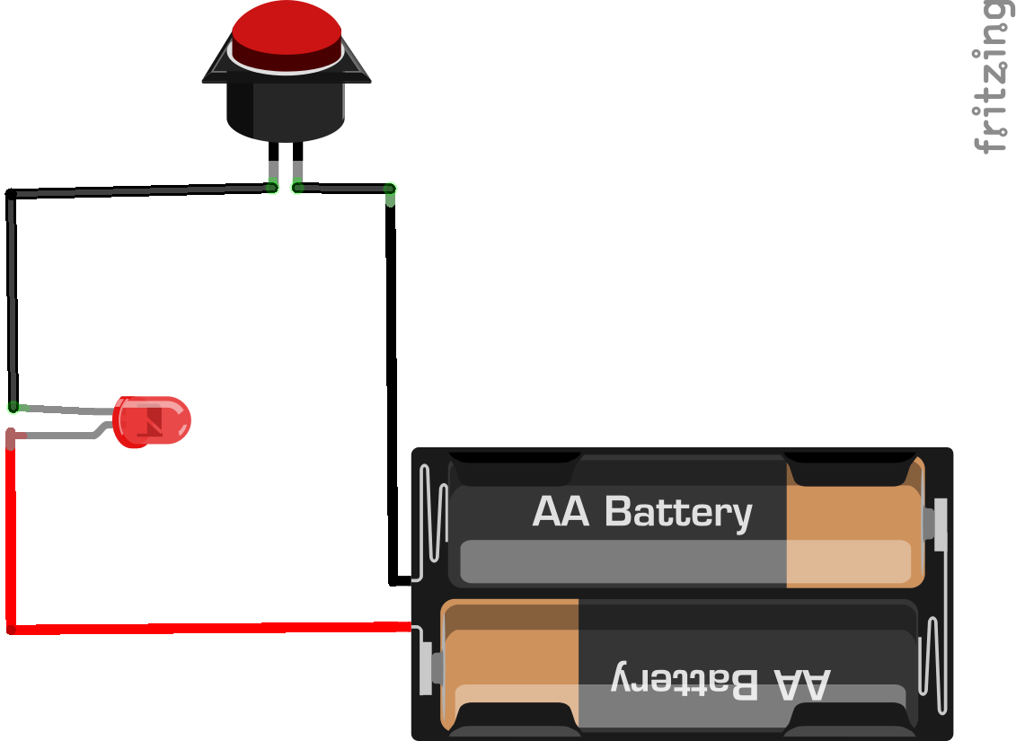
How a button works
Notes:
Explain the features of a button and circuit, use everyday examples like lights, computer, turning your phone on.
Button examples can include, keyboards, vending machines,

Slide 6
Events
from microbit import *
button_a.is_pressed():
display.show(Image.HAPPY)
Notes:
Discuss what the program does
What is the code to control the button?
Ask the Learners how to control Button B

Slide 7
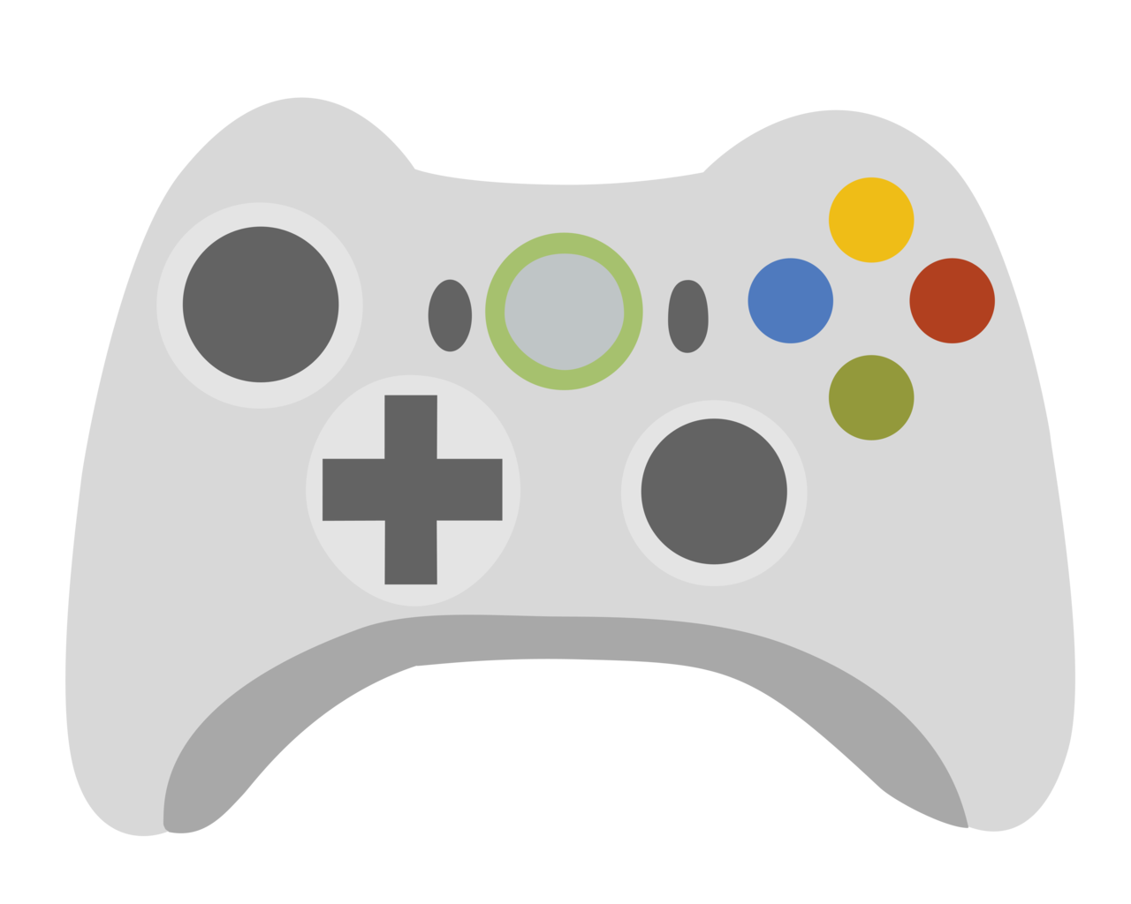
Selection
Selection is about ‘selecting’ or responding with several events when a button is pressed
Consider a games controller where you have many buttons, what can they do?
This Photo by Unknown Author is licensed under CC BY-SA
Notes:
Talk through the games controller and that it can be used to control many events in a game, jump, run, duck, reload, save, this uses selection.
Ask how the controller knows what event to trigger – it is coded

Slide 8
Selection
Selection is about ‘selecting’ or responding. It uses three main elements
if
elif
else
Sometimes selection is referred to as an if statement. It always ends with the else statement.

Slide 9
Selection
Look at the simple everyday example below:
if you are felling hungry:
Eat some food
elif if you are feeling thirsty:
Have a drink
else:
Do nothing
.
Notes:
Ask Learners to create their own Selection statements

Slide 10
Selection
Look at the simple everyday example below:
if the car fuel is 25% or lower :
Display orange fuel light
elif the car fuel is less than 10%:
Display red fuel light and nearest petrol station directions
else:
Display no fuel light
.
Notes:
Ask Learners to create their own Selection statements

Slide 11
Selection
from microbit import *
while True:
if button_a.is_pressed():
display.show(Image.HAPPY)
else:
display.show(Image.SAD)
display.clear()
Notes:
Talk through program, ask Learners to identify the selection and the event that happens? What triggers the events? [pressing Button A]. Refer to the while True being a loop which keeps the program repeating.

Slide 12
Event Handling
When using selection we often use a loop to keep to program repeating
At some point we will want to end or ‘break out’ of the loop
This is known as an interrupt
Imagine that you were talking and someone interrupted you, you would stop talking

Slide 13
Event Handling – Interrupts
from microbit import *
while True:
if button_a.is_pressed():
display.show(Image.HAPPY)
elif button_b.is_pressed():
break
else:
display.show(Image.SAD)
display.clear()
Can you spot the interrupt?
What does it do?
What event triggers the interrupt?
Notes:
Talk and discuss the program. What does it do? Answer the questions about the interrupts.

